Slide 1
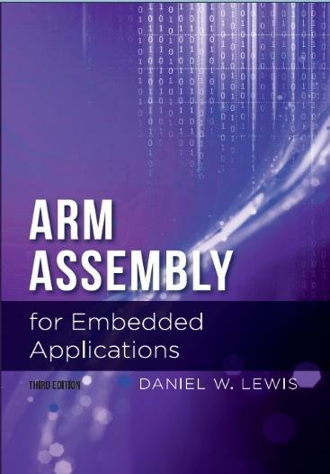
Chapter 12
Rational and Complex Arithmetic

Slide 2
Why Rational Numbers?
int main()
{
float x ;
x = (0.5 – 0.4 – 0.1) ;
if (x == 0.0) printf("Zero\n") ;
else printf("Non-Zero\n") ;
return 0 ;
}

Slide 3
Aggregate Data Types
An aggregate data type is one that contains more than one value.
Examples in C:
Arrays and structs.
Applications:
Complex numbers (have a real and an imaginary part)
Rational numbers (expressed as the ratio of two integers)

Slide 4
Arrays, Structs and Functions
Functions and arrays:
An array parameter is passed as its address
A function may not return an array.
Functions and structs:
A struct parameter is passed by value (a copy)
A function may return a struct
Not a good choice for Complex or Rational.

Slide 5
Using a Structure as a Container
We could use a struct to create a programmer–defined data type:
typedef struct typedef struct
{ {
float real ; int top ;
float imag ; int btm ;
} COMPLEX ; } RATIONAL ;
COMPLEX x = {1.5, -3.7} ; RATIONAL x = {1, 3} ;

Slide 6
Pros and Cons of Structures
Advantage of struct:
Cleaner and intuitive C syntax for accessing member elements
Disadvantage of struct:
Since the size of a struct is not limited, compilers may call a (slow) memory-to-memory copy routine to create the pass-by-value copy.

Slide 7
The AAPCS, the FPU, and Structures
Parameters that are a struct of 1-4 floats or 1-4 doubles are passed in a sequence of sequentially numbered floating-point registers
typedef struct {float a, b, c, d} STUFF ;
void foo(STUFF) ; // function prototype
STUFF x = {1.1, -3.2, 7.1. -10.8} ;
…
foo(x) ;
…
VLDR S0,x.a
VLDR S1,x.b
VLDR S2,x.c
VLDR S3,x.d
BL foo
…

Slide 8
The AAPCS, the FPU, and Structures
Functions return a struct of 1-4 floats or 1-4 doubles in a sequence of floating-point registers starting with S0 or D0.
typedef struct {float a, b, c, d} STUFF ;
STUFF foo(void) ; // function prototype
STUFF x = {1.1, -3.2, 7.1. -10.8} ;
…
x = foo() ;
…
BL foo
VSTR S0,x.a
VSTR S1,x.b
VSTR S2,x.c
VSTR S3,x.d
…

Slide 9
The AAPCS and Structures of Ints
The AAPCS doesn't use a sequence of integer registers for structures containing 1-4 integers because there are only four integer registers that can be used for function parameters.
We need a different strategy when the member elements are not floats! (E.g., integers or fixed-point reals)

Slide 10
Using a Native Data Type as a Container
Data Type | Bits | Passed In Registers | Use as a container for …
uint32_t | 32 | R0-R3 | (4) 8-bit integers, or (2) 16-bit integers or fixed-point reals
uint64_t | 64 |  | (8) 8-bit integers, or (4) 16-bit or (2) 32-bit integers or fixed-point reals
double | 64 | D0-D7 | (2) single-precision reals (floats)
Registers determined by native data type
Most efficient choices based on registers

Slide 11
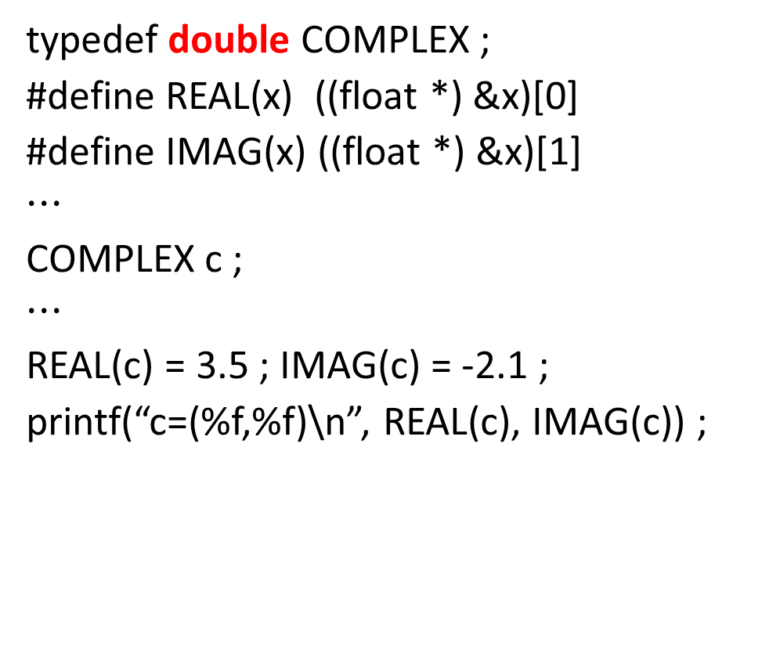
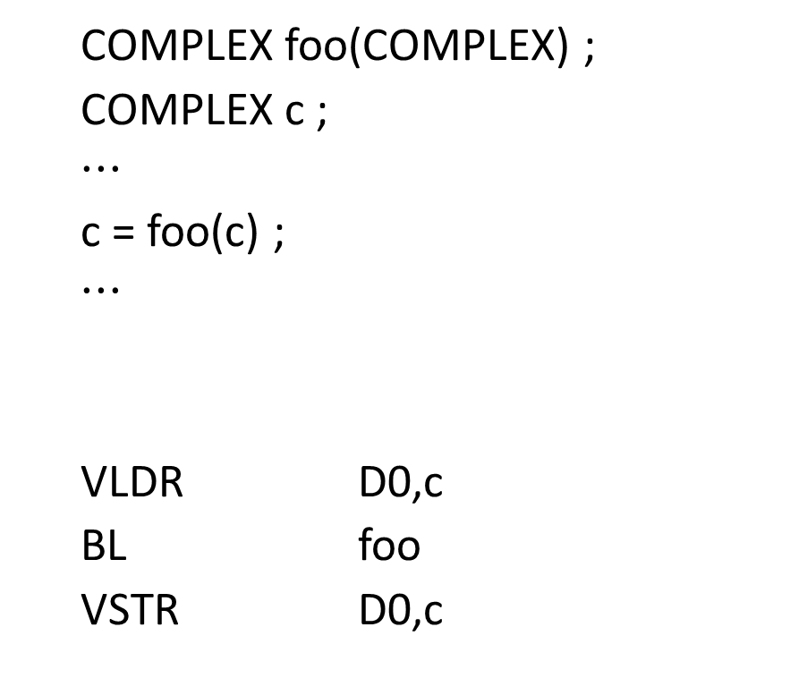
Using a Native Data Type as a Container
typedef double COMPLEX ;
#define REAL(x) ((float *) &x)[0]
#define IMAG(x) ((float *) &x)[1]
$$⋯$$
COMPLEX c ;
$$⋯$$
REAL(c) = 3.5 ; IMAG(c) = -2.1 ;
printf(“c=(%f,%f)\n”, REAL(c), IMAG(c)) ;
COMPLEX foo(COMPLEX) ;
COMPLEX c ;
$$⋯$$
c = foo(c) ;
$$⋯$$
VLDR D0,c
BL foo
VSTR D0,c
D0 is another name for the register pair S0,S1
Parameters are passed and result returned in floating-point registers.

Slide 12

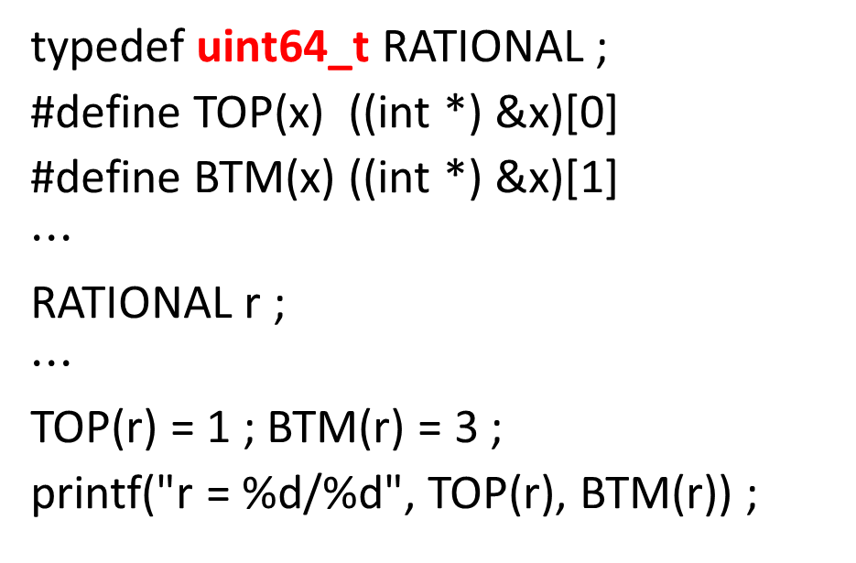
Using a Native Data Type as a Container
typedef uint64_t RATIONAL ;
#define TOP(x) ((int *) &x)[0]
#define BTM(x) ((int *) &x)[1]
$$⋯$$
RATIONAL r ;
$$⋯$$
TOP(r) = 1 ; BTM(r) = 3 ;
printf("r = %d/%d", TOP(r), BTM(r)) ;
RATIONAL foo(RATIONAL) ;
RATIONAL r ;
$$⋯$$
r = foo(r) ;
$$⋯$$
LDRD R0,R1,r
BL foo
STRD R0,R1,r
Parameters are passed and result returned in integer registers.

Slide 13
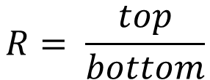
Using uint32_t to Hold a Rational Number
31 | 16 | 15 | 0
top (int16_t) |  | bottom (int16_t)
$$R= \frac{top}{bottom}$$

Slide 14
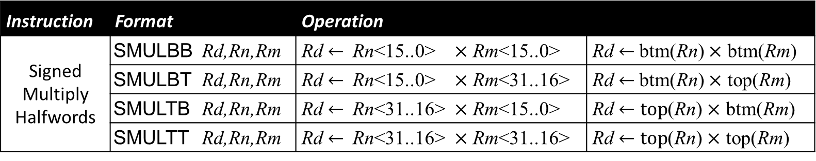


Using uint32_t to Hold a Rational Number
$$a±b= \frac{top(a)}{btm(a)}±\frac{top(b)}{btm(b)}= \frac{top\left(a\right)×btm\left(b\right)±btm(a)×top(b)}{btm(a)×btm(b)}$$
$$a×b= \frac{top(a)}{btm(a)}×\frac{top(b)}{btm(b)}= \frac{top(a)×top(b)}{btm(a)×btm(b)}$$
$$a÷b= \frac{top(a)}{btm(a)}×\frac{btm(b)}{top\left(b\right)}= \frac{top(a)×btm(b)}{btm(a)×top(b)}$$
Instruction | Format |  | Operation
Signed Multiply Halfwords | SMULBB | Rd,Rn,Rm | Rd $←$Rn<15..0> $×$ Rm<15..0> | Rd $←$btm(Rn) $×$ btm(Rm)
 | SMULBT | Rd,Rn,Rm | Rd $←$Rn<15..0> $×$ Rm<31..16> | Rd $←$btm(Rn) $×$ top(Rm)
 | SMULTB | Rd,Rn,Rm | Rd $←$Rn<31..16> $×$ Rm<15..0> | Rd $←top$(Rn) $×$ btm(Rm)
 | SMULTT | Rd,Rn,Rm | Rd $←$Rn<31..16> $×$ Rm<31..16> | Rd $←top$(Rn) $×$ top(Rm)

Slide 15

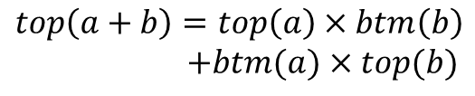





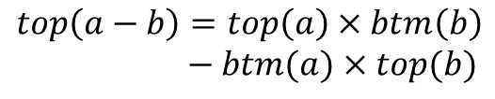
Using uint32_t to Hold a Rational Number
// a + b: RATIONAL RAdd(RATIONAL a, RATIONAL b) ;
// a - b: RATIONAL RSub(RATIONAL a, RATIONAL b) ;
// a * b: RATIONAL RMul(RATIONAL a, RATIONAL b) ;
// a / b: RATIONAL RDiv(RATIONAL a, RATIONAL b) ;
RAdd: SMUADX R2,R0,R1 // top = TOP(R0)*BTM(R1) + BTM(R0]*TOP(R1]
SMULBB R3,R0,R1 // btm = BTM(R0)*BTM(R1)
PKHBT R0,R3,R2,LSL 16 // sum = (top << 16) | btm
BX LR
RSub: SMUSDX R2,R1,R0 // top = TOP(R0)*BTM(R1) - BTM(R0]*TOP(R1]
SMULBB R3,R0,R1 // btm = BTM(R0)*BTM(R1)
PKHBT R0,R3,R2,LSL 16 // diff = (top << 16) | btm
BX LR
RMul: SMULTT R2,R0,R1 // top = TOP(R0)*TOP(R1)
SMULBB R3,R0,R1 // btm = BTM(R0)*BTM(R1)
PKHBT R0,R3,R2,LSL 16 // prod = (top << 16) | btm
BX LR
RDiv: SMULTB R2,R0,R1 // top = TOP(R0)*BTM(R1)
SMULBT R3,R0,R1 // btm = BTM(R0)*TOP(R1)
PKHBT R0,R3,R2,LSL 16 // quot = (top << 16) | btm
BX LR
$$top\left(a+b\right)=top\left(a\right)×btm\left(b\right)$$ $+btm(a)×top(b)$
$$btm(a+b)=btm(a)×btm(b)$$
$$top\left(a−b\right)=top\left(a\right)×btm\left(b\right)$$ $− btm(a)×top(b)$
$$btm(a−b)=btm(a)×btm(b)$$
$$top\left(a×b\right)=top(a)×top(b)$$
$$btm\left(a×b\right)=btm(a)×btm(b)$$
$$top(a÷b)=top(a)×btm(b)$$
$$btm(a÷b)=btm(a)×top(b)$$

Slide 16
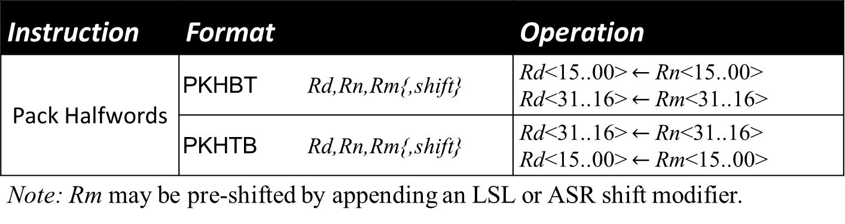
Using uint32_t to Hold a Rational Number
Instruction | Format |  | Operation
Pack Halfwords | PKHBT | Rd,Rn,Rm{,shift} | Rd<15..00> $←$Rn<15..00> Rd<31..16> $←$Rm<31..16>
 | PKHTB | Rd,Rn,Rm{,shift} | Rd<31..16> $←$Rn<31..16> Rd<15..00> $←$Rm<15..00>
Note: Rm may be pre-shifted by appending an LSL or ASR shift modifier.
PKHBT Rd,Rn,Rm
PKHTB Rd,Rn,Rm
Rn
0x1234
0x5678
Rn
0x1234
0x5678
Rd
0x9ABC
0x5678
Rd
0x1234
0xDEF0
Rm
0x9ABC
0xDEF0
Rm
0x9ABC
0xDEF0

